Slide 1


Slide 2
Multithreaded approach to PythonSV
Workload pipeline optimization and fatal equipment failure handling
Sivan Zusin MPE IDC ATE IO DV

Slide 3

Main Idea
Current workflow
Based on serial operations
Many long operations are independent
Results with lots of ‘dead’ time
Suggested workflow
Based on parallel operations
Concurrent execution of multiple time-consuming tasks independently
Minimizes dead time during testing
Yields faster results
Successful handling of previously test-stopping equipment malfunctions

Slide 4
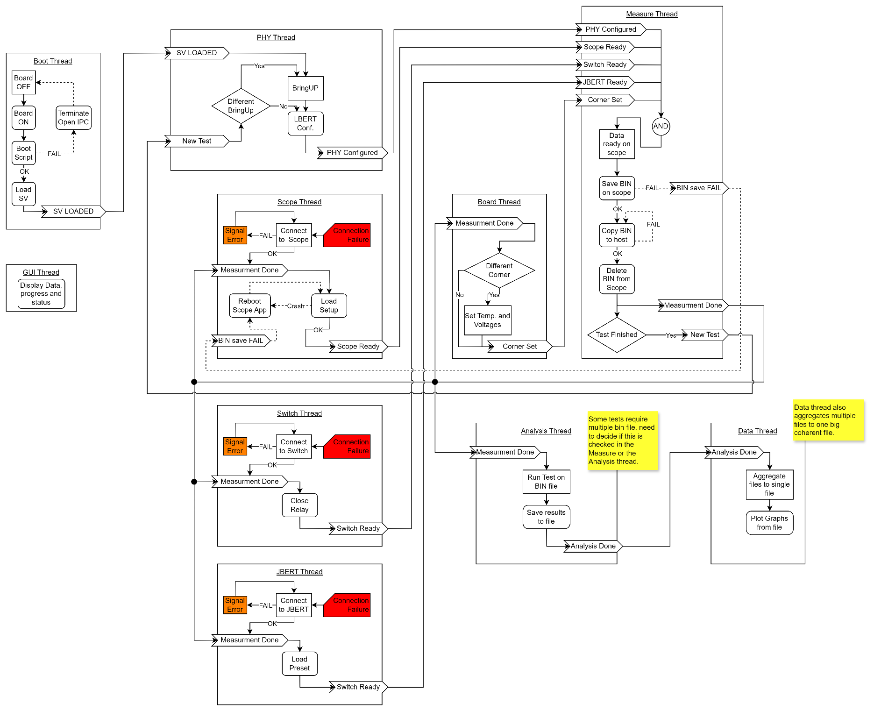
Block Diagram

Slide 5
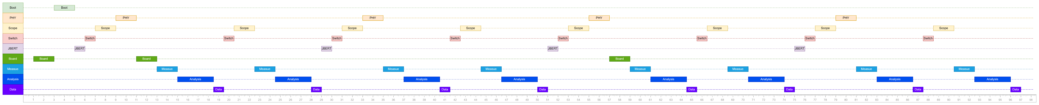
Timing Example
Simulation of a 2 corner, 2 PHYs, 2 lanes test

Slide 6
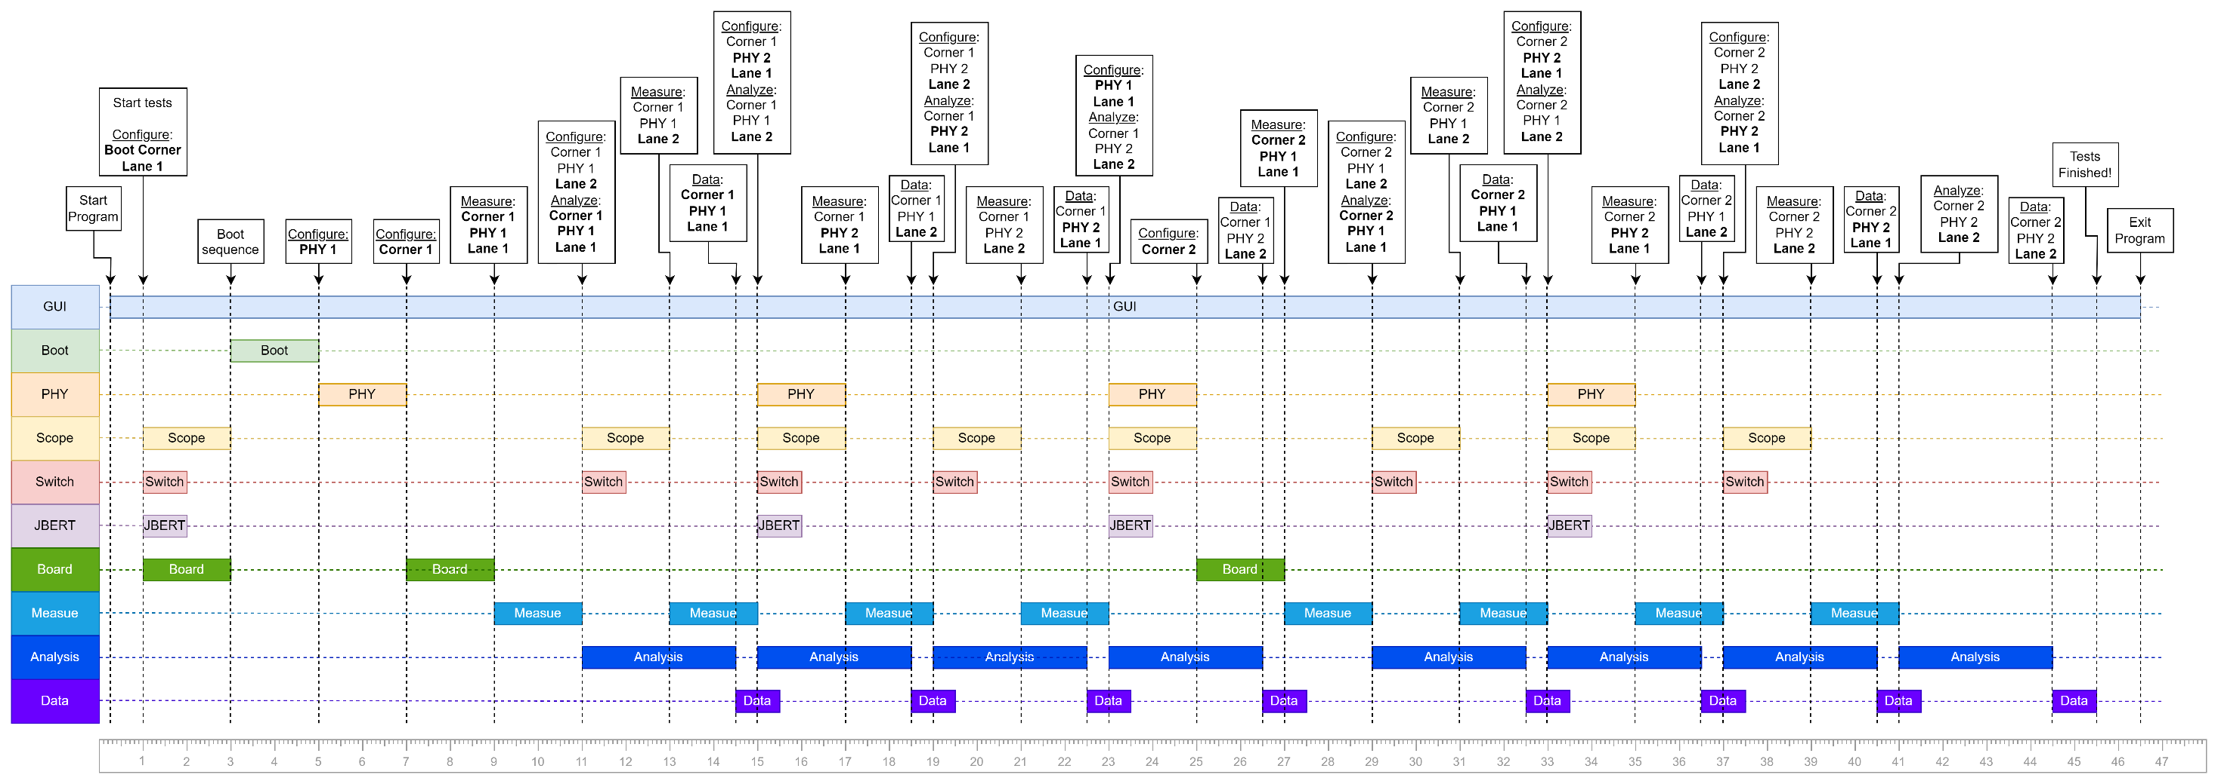
Timing Example
Simulation of a 2 corner, 2 PHYs, 2 lanes test

